Slide 1


WELCOME USAV/LSR MEMBERS
2025-26 Referee Clinic

Slide 2

Respect Others
Let’s Learn Together!
Please:
  Turn off cell phones, silence or put into airplane mode.
  Pay attention, everyone can learn something new.
  Keep conversations to clinic-related topics.
  If you have a question, ask it please.
  If you must accept a call, please step out of the room so you do not disturb those around you.

Slide 3
Lone Star Region
Contacts
Email or Mail your
completed
Rating forms to:
Commissioner
Scorer Chair
Referee Chair
Will Vick
1608 Canyon Oak
Shertz, TX 77154
willvick@satx.rr.com
210.945.4365
Joe Campbell
5110 Binion Forest Lane.
Spring, TX 77389
lsrscorechair@gmail.com
Joe Lizama
3733 Morgan Mill Rd
Kempner, TX. 76539
LSRRefereeChair@gmail.com

Slide 4
TODAY’S AGENDA
    Requirements for a Referee Certification
    New Rules Changes
    First and Second Referee Duties
    Coin Toss
    Group Discussion & Interaction
    Points of Emphasis
    Sanctions, Signals & Mechanics
    Harassment Incident Response Officials & Staff (HIROS)
    Sample Test Questions
    Test

Slide 5
WANT TO BE A PAID REFEREE???
If you want to be a paid referee, this is not the correct clinic.
You must attend a REFEREE 4 PAY (R4P) clinic that is designed for paid referees.
The R4P clinics are scheduled in November at 3 major cities: Austin, Houston, San Antonio.
The location, date, times are posted on the LSR website.

Slide 6


LSR Referee Certification Requirements
Complete Registration with USAV and Lone Star Region.
Complete Background Check (Adults).
Complete SafeSport Certification.
Pay Applicable Fees.
Attend and Pay Referee Clinic Fee.
Take and Pass Your Test.

Slide 7
What certification are you trying to achieve?
You are an ADULT
You are a JUNIOR
REGIONAL
PROVISIONAL
ADULT R2
JUNIOR R1 = Age 16-18 only
JUNIOR R2 = Age 18 and below
This is based on your
age and not on the age
of the team you coach
Junior R1 is for athletes who
would like to R1, and possibly
referee for pay

Slide 8
REFEREE CERTIFICATION / RATINGS
Remember: you choose your certification, once you depart the clinic, you cannot change that certification.
Follow through and complete your certification
  For JR1 & Provisional: R1 & R2 ratings required.
  For JR2 & Adult R2: Two R2 ratings required.
  For Regional: R1 & R2 ratings / National-level official to perform the ratings / 14’s age group match.

Slide 9
A COMPLETED
Certification is good for two seasons.
Who Can Rate??
  Junior and Provisional Certification–must be rated by a Regional or higher-certified referee on the Lone Star Region rating form at a match, tournament, or any event using USAV rules.
  Regional Certification–must be rated by Junior National or National certified referee (on the USAV rating forms) in a tournament setting (age 14 or higher match).

Slide 10
WHERE CAN I GET MY RATINGS
Attend a paid referee tournament: You can only obtain an R2 rating as you are not allowed to R1 if you are coaching.
Attend a non-paid referee tournament: Go and volunteer to R1 and R2 one match each. A Regional or higher referee can do the ratings.
Have your club host a Rating Session:
  National-level and Regional referees will be there to perform the ratings.
  Players must wear numbered jerseys.
  If you are obtaining a Regional certification, you must be rated on a 14’s or older match.

Slide 11
REGIONAL REREREE REQUIREMENT
All certified REGIONAL referees must obtain as a minimum a PROVISIONAL scorer certification.
If you did not obtain your scorer certification last season, you “must” obtain it this season or risk losing your Regional certification.
After the 2nd season as a certified scorer, you can either recertify or send 2 completed sets (from a live match) to the referee chair to confirm your proficiency.

Slide 12
R1 & R2 Rating Form
It is your responsibility to submit your 2 ratings to complete your certification.
PLEASE, accomplish them quickly so you don’t forget. Don’t wait until you have both to turn them in.
All the header information on the form must be filled in.
Fill in “Current Rating” and “Recommendation” boxes.
You must SIGN the rating form in the appropriate section.
The rater must PRINT their name and fill in their Rating.
When you e-mail them to Joe Lizama, they must be attached to your e-mail as a JPG, JPEG, or PDF. DO NOT put the form in the body of the e-mail.

Slide 13
REMEMBER…
LSR Regionals Requirements
ALL TEAMS that will play in the BID Division of the LSR Regionals are required to have a “CERTIFIED” Regional, Provisional or Adult R2 referee on their roster.
If your team plans to participate in a non-paid referee tournament, you must have an in-progress PROVISIONAL referee for your team.
You cannot have “only one” coach who is a Provisional or Regional certified referee on two rosters in the same tournament.

Slide 14
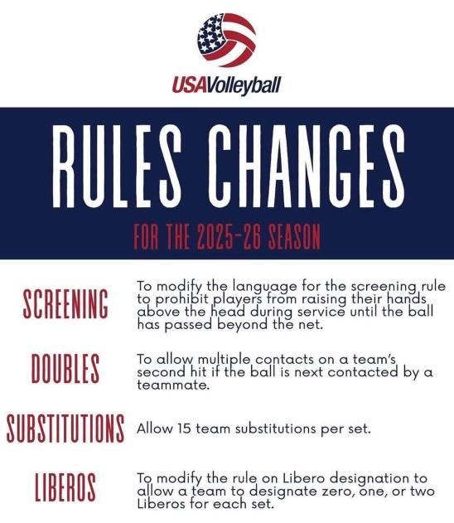
14

Slide 15
RULES CHANGES: 2025-2026
Proposal #1: To modify the language for the screening rule to prohibit players from raising their hands above the head during service until the ball has passed beyond the net.
Rationale: To enhance fair play and as a safety precaution.
Rules Book Language:
12.5.3: Any player of the serving team is forbidden to raise their hands above the head during service, until the ball has passed beyond the net. The 1st referee may warn a team through the game captain, if he/ she suspects that the team is deliberately screening.
15

Slide 16
RULES CHANGES: 2025-2026
Proposal #5: To allow multiple contacts on a team’s second hit if the ball is next contacted by a teammate.
Rationale: To allow more exciting rallies and reduce the number of rallies ended by a fault.
Rules Book Language: (Will adopt the FIVB language for this rule change)
9.2 Characteristics of the Hit
9.2.3: The ball may touch various parts of the body, provided the contacts take place simultaneously.
16

Slide 17
RULES CHANGES: 2025-2026
Exceptions:
9.2.3.2: at the first hit of the team, the ball may contact various parts of the body consecutively, provided that the contacts occur during one action. At the second hit of the team, the ball may contact various parts of the body consecutively, provided that the contacts occur during one action, and the ball is next touched by a teammate.
9.3 Faults in Playing the Ball
DOUBLE CONTACT: a player hits the ball twice in succession or the ball contacts various parts of his/her body in succession on the third team hit or on the second team hit and the ball is not next touched by a teammate. (see also 9.2.3)
17

Slide 18
RULES CHANGES: 2025-2026
Rules Interpretations (additional interpretations will be written):
A double contact is called if a player hits the ball twice in succession or the ball contacts various parts of his/her body in succession on the third team hit or on the second team hit and the ball is not next touched by a teammate.
SCENARIO 1: The Team S setter clearly double hits the team’s second contact. The ball travels toward teammate S #4 but crosses the net without being touched by S#4 or any other teammate.
RULING: The 1st referee whistles a double contact and awards a point and the serve to Team R.
18

Slide 19
RULES CHANGES: 2025-2026
SCENARIO 2: The Team S setter clearly double hits the team’s second contact. The ball travels toward teammate S #4 and is contacted simultaneously by S #4 and a Team R blocker.
RULING: The 1st referee allows play to continue. After a double contact, if there is simultaneous contact in the plane of the net between a teammate and an opponent, the double contact is not a fault.
19

Slide 20
RULES CHANGES: 2025-2026
Proposal #4: To modify the rule for substitutions to allow 15 team substitutions per set.
Rationale: To create opportunities for more players to enter the match and to allow more playing time for players.
Rules Book Language:
USAV 15.1: Each team may request a maximum of two time-outs and 15 substitutions per set.
USAV 15.6a: Fifteen substitution are the maximum permitted per team per set. Substitution of one or more players is permitted at the same time.
USAV 15.6d: Unlimited individual entries by a substitute within the team’s allowable 15 substitutions are permitted.
20

Slide 21
RULES CHANGES: 2025-2026
Proposal #6: To modify the rule on Libero designation to allow a team to designate zero, one, or two Liberos for each set.
Rationale: To allow create more flexibility in team lineups and allow teams to use more players in the Libero position if desired.
Rules Book Language:
USAV 19.1.1: Each team has the right to designate from the list of players on the score sheet (roster) up to two specialized defensive players called Liberos. A team may designate zero, one, or two Liberos for each set. If the team chooses to designate two Liberos at the start of the match, they are designated as Liberos for the entire match. If the team chooses to designate only one Libero (or no Libero) at the start of the match, the team may choose to change the player designated as Libero for each set, including playing any set with no Libero, but may not designate a second Libero for any subsequent set in the match.
21

Slide 22
RULES CHANGES: 2025-2026
New USAV 20.3 Filming and Recoding of Matches
  20.3.1: Athletes, Coaches, and team members on the bench are permitted to record audio and video for each team use. However, these recordings must not be used to intimidate, demoralize, or bully other teams, officials, the work team, support staff, or spectators. Additionally, teams may not record a conversation with a referee or the work team. If a team is found to have recorded these groups and used the audio or video to engage in such behavior, USA Volleyball will enforce regional and national policies accordingly, and content will be evaluated through the Code of Conduct lens and other protection focused programs such as HIROS.

Slide 23
RULES CHANGES: 2025-2026
New USAV 20.3 Filming and Recoding of Matches
  20.3.2: Players on the court are not permitted to wear microphones. If the referee(s) discover a player on the court wearing a microphone, the match is stopped, and the player is asked to remove the microphone. The offending team is issued a delay warning due to unauthorized equipment.
  20.3.3: Teams may not post any audio and/or video in a public forum (including social media accounts) with the intent of making fun of, criticizing, or mocking the officials, the work team, the opponent, or the tournament. Discovery of such audio and/or video will result in penalties as determined by USA Volleyball.

Slide 24
New REFEREE TECHNIQUE
Same player makes third and fourth team hits:
  Signal “four hits” (Signal 18).

Slide 25
R1 – Duties and Responsibilities
Conduct coin toss with both captains.
Has final decision on all rallies as needed.
Manage the match with officiating and work teams.
Warn or Sanction as needed.
Have strong, loud and crisp whistle.
Display good and confident signals and mechanics.
Have a good tempo throughout the match.
Decide on faults at net play for back row attacks, back row blocks, reaching over and etc.
Help out R2 on net and center line faults.
Sign score sheet at the end of the match.

Slide 26
R1 – Ball Handling
Consistency:
  Adjust to the age and skill level
  Don’t be influenced (spin, technique or fans comments)
  Only R1 can whistle Ball Handling
  Only the contact point should be considered when judging legality
  There is no body/ball position or playing technique that automatically results in illegal contact.

Slide 27
R1 – Ball Handling
Guidelines:
  Catch – Overcontrol
  Throw – Lack of control
  Double Contact: Judge contact for second and third ball over the net
  We do not use the term LIFT. Proper terminology is CATCH (Illegal Contact)
  Mishandled balls resulting in a blatant fault should still be called at ALL ages
  Less severe judgment is applied to a contact by a player who makes a challenging or spectacular play
Judge the contact of the ball:
  Sometimes Ugly is simply UGLY but not illegal

Slide 28
R2 Duties and Responsibilities
Assist the R1 with back row attacks, back row blocks, reaching over.
Whistle net faults and center line faults.
Watch for out of rotations and out of positions.
Manage Subs and T/Os.
Work with table crew.
Whistle when the ball hits the antenna on R2 side or ball travels outside antenna.
Transition to the blocking side during the rally.
At the end of the rally step to the faults side away from the pole and mirror R1’s signals.

Slide 29
R2 PROTOCOL
Check the lineup while standing in the sub zone.
Allow Libero to enter the court – sweeping arm motion.
Leave the ball on the table – indicate the Capt. to the R1.
Check w/scorer’s table to ensure they are ready.
Check the benches for water bottles, backpacks, children.
Benches – how many coaches standing, players standing.
Move to the receiving team’s side.
NO EARBUDS & NO CELL PHONES at the table, or w/LJ’s.

Slide 30
R2 PROTOCOL cont.
Give the court to the R1 as you are now ready to begin.
Put your whistle in your mouth.
Stand parallel with the court.
Watch the receiving team for positional faults.
Your decision to warn or to whistle the positional fault.
Know the rules for a positional fault and explain if necessary.
If you whistle, do so loudly and know that you are correct.

Slide 31
DISRUPTIVE COACH
USAV has indicated that this is a problem nation wide. We must do our best to address it when it happens – don’t just ignore the coach and hope that he/she will stop.
How to handle a disruptive coach as an R2:
  Remain Calm
  R2 walk to the coach, listen to them
  Address their concern, then move on
  Do not allow the coach into the SUB zone
  If the coach yells at the R1-redirect them to you
  Request a sanction when warranted

Slide 32
Advantages on Knowing your Scoresheet and Forms
If something goes wrong, the match OFFICIALS CAN fix it.
Time is saved as you don’t have to wait for someone to come to the court to CORRECT THE SITUATION.
Consider a Scoring Clinic to be KNOWLEDGEABLE with the SCORESHEET and LIBERO CONTROL SHEET.
If you are a Regional referee, or moving up to a Regional certification, obtaining a Provisional scorer certification is a requirement.

Slide 33
SAFETY AROUND THE COURT – PARAMOUNT!!!
These include, Wagons, sisters/brothers playing, tripods, people, bags, drinks, strollers, an ottoman (yes), chairs, team gatherings, crutches, and scorer’s tables!
These things are obstructing most free zones these days. There are oblivious refs who stand in the way of hitters as a team is warming up. Somewhere along the way we’ve forgotten that this is about the players and the sport. We have created this environment where the spectators and players think they have the right to be in very unsafe places. Most every email about officiating tourneys these days lists time management as the most important thing we do, at least it is mentioned first and foremost. Providing a safe and fair environment is maybe at least as important as getting out of the gym early?
From an LSR National Referee

Slide 34




Time for a
BREAK!
Be Back In
1
0
0
5
4
3
2
1
0
0
9
8
7
6
5
4
3
2
1
0
9
8
7
6
5
4
3
2
1
0
9
8
7
6
5
4
3
2
1
0
9
8
7
6
5
4
3
2
1
0
9
8
7
6
5
4
3
2
1
0
9
8
7
6
5
4
3
2
1
0
0
0
0
9
Hours
Minutes
Seconds

Slide 35
Time for a
BREAK!
Be Back In
0
0
5
4
3
2
1
0
0
9
8
7
6
5
4
3
2
1
0
9
8
7
6
5
4
3
2
1
0
9
8
7
6
5
4
3
2
1
0
9
8
7
6
5
4
3
2
1
0
9
8
7
6
5
4
3
2
1
0
9
8
7
6
5
4
3
2
1
0
0
9
0
8
Hours
Minutes
Seconds

Slide 36
Time for a
BREAK!
Be Back In
0
0
5
4
3
2
1
0
0
9
8
7
6
5
4
3
2
1
0
9
8
7
6
5
4
3
2
1
0
9
8
7
6
5
4
3
2
1
0
9
8
7
6
5
4
3
2
1
0
9
8
7
6
5
4
3
2
1
0
9
8
7
6
5
4
3
2
1
0
0
8
0
7
Hours
Minutes
Seconds

Slide 37
Time for a
BREAK!
Be Back In
0
0
5
4
3
2
1
0
0
9
8
7
6
5
4
3
2
1
0
9
8
7
6
5
4
3
2
1
0
9
8
7
6
5
4
3
2
1
0
9
8
7
6
5
4
3
2
1
0
9
8
7
6
5
4
3
2
1
0
9
8
7
6
5
4
3
2
1
0
0
7
0
6
Hours
Minutes
Seconds

Slide 38
Time for a
BREAK!
Be Back In
0
0
5
4
3
2
1
0
0
9
8
7
6
5
4
3
2
1
0
9
8
7
6
5
4
3
2
1
0
9
8
7
6
5
4
3
2
1
0
9
8
7
6
5
4
3
2
1
0
9
8
7
6
5
4
3
2
1
0
9
8
7
6
5
4
3
2
1
0
0
6
0
5
Hours
Minutes
Seconds

Slide 39
Time for a
BREAK!
Be Back In
0
0
5
4
3
2
1
0
0
9
8
7
6
5
4
3
2
1
0
9
8
7
6
5
4
3
2
1
0
9
8
7
6
5
4
3
2
1
0
9
8
7
6
5
4
3
2
1
0
9
8
7
6
5
4
3
2
1
0
9
8
7
6
5
4
3
2
1
0
0
5
0
4
Hours
Minutes
Seconds

Slide 40
Time for a
BREAK!
Be Back In
0
0
5
4
3
2
1
0
0
9
8
7
6
5
4
3
2
1
0
9
8
7
6
5
4
3
2
1
0
9
8
7
6
5
4
3
2
1
0
9
8
7
6
5
4
3
2
1
0
9
8
7
6
5
4
3
2
1
0
9
8
7
6
5
4
3
2
1
0
0
4
0
3
Hours
Minutes
Seconds

Slide 41
Time for a
BREAK!
Be Back In
0
0
5
4
3
2
1
0
0
9
8
7
6
5
4
3
2
1
0
9
8
7
6
5
4
3
2
1
0
9
8
7
6
5
4
3
2
1
0
9
8
7
6
5
4
3
2
1
0
9
8
7
6
5
4
3
2
1
0
9
8
7
6
5
4
3
2
1
0
0
3
0
2
Hours
Minutes
Seconds

Slide 42
Time for a
BREAK!
Be Back In
0
0
5
4
3
2
1
0
0
9
8
7
6
5
4
3
2
1
0
9
8
7
6
5
4
3
2
1
0
9
8
7
6
5
4
3
2
1
0
9
8
7
6
5
4
3
2
1
0
9
8
7
6
5
4
3
2
1
0
9
8
7
6
5
4
3
2
1
0
0
2
0
1
Hours
Minutes
Seconds

Slide 43
Time to be
BACK!
Be Back In
0
0
5
4
3
2
1
0
0
9
8
7
6
5
4
3
2
1
0
9
8
7
6
5
4
3
2
1
0
9
8
7
6
5
4
3
2
1
0
9
8
7
6
5
4
3
2
1
0
9
8
7
6
5
4
3
2
1
0
9
8
7
6
5
4
3
2
1
0
0
1
0
0
Hours
Minutes
Seconds

Slide 44
NET FAULT
11.3 Contact with the Net
11.3.1: Contact with the net by a player between the antennae, during
the action of playing the ball, is a fault. The action of playing the
ball includes (among others) take-off, hit (or attempt) and landing
safely, ready for a new action.
11.3.2: Players may touch the post, ropes, or any other object outside
the antennae, including the net itself, provided that it does not
interfere with play.
11.3.3: When the ball is driven into the net, causing it to touch an
opponent, no fault is committed.

Slide 45
Centerline Violation
Centerline violation is one of the most misunderstood rule. You need to understand there is a judgement that must be made when a possible centerline violation occurs.
USAV 11.2.2.2: to touch the opponent’s court with any part(s) of the body is permitted, provided some part of the body remains either in contact with or directly above the center line, and there is no interference with opponents. In addition, completely crossing the center line with the foot, feet, or hands, or encroachment with other body parts, must not present a safety hazard to opponents.

Slide 46
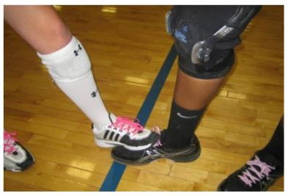
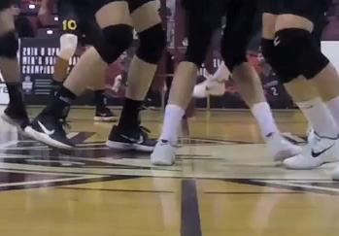
Centerline Violation
A – Fault or No Fault?
B – Fault or No Fault?
A
Remember
A violation is based on two areas of criteria:
Interference
Safety Hazard
Was partial penetration with incidental contact a fault?
What is the proper distance between players to consider a safety hazard?
B

Slide 47
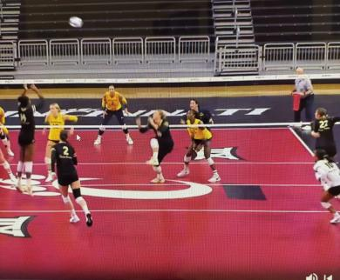
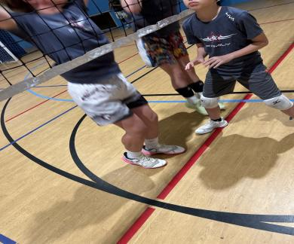
Centerline Violation
A.
A – Fault or No Fault?
B – Fault or No Fault?
Remember
A violation is based on two areas of criteria:
Interference
Safety Hazard
What is the proper distance between players to consider a safety hazard?
Was partial penetration without contact a fault?
B.

Slide 48
COIN TOSS
The winner of the toss will get 1 of 3 choices.
  Serve
  Receive
  Chose the side (bench)
In the LSR we DO NOT switch sides between sets.
3rd Set Coin Toss: can only choose to serve or receive
There is no HOME or VISITORS like in high school and college.
The R1 will assign one side of the coin to TEAM A, and the other side of the coin to TEAM B.
  Example: Team A - Heads
  Team B - Tails
  Team A - Blue
  Team B - Red

Slide 49
HOW MUCH DO YOU KNOW
Break into groups of 3 to 5 people

Slide 50
HOW MUCH DO YOU KNOW
Which coaches can stand, and where can they stand?
What are some examples of an Improper Request, and what is the signal from the R1?
Should the R2 ever give an “Overt” in/out signal when the ball lands near their sideline?
How does the referees handle a late Libero Exchange?
When can an R2 whistle to kill the play?
LJ1 calls the ball “in” LJ2 calls the ball “out”
What’s the call?

Slide 51
HOW MUCH DO YOU KNOW
Explain the differences between Expulsion and Disqualification
Explain the differences in serving between 14’s and younger vs 15’s and older
Explain the differences between Forfeit and Default
Explain the rules in having 1, 2, or no Libero per set
Explain the fault for a Libero setting the ball with finger action in the front zone
Explain an Exceptional Substitution

Slide 52
LSR POINT OF EMPHASIS
LINE JUDGE FOOTWEAR
  Must wear appropriate footwear in the region.
  NO Flip-flops, fuzzy slippers, and or any other type of sandal, “unless” there is a strap on the back, or it is fully enclosed around the foot
  Barefoot or Wearing only Socks are not allowed!
EARBUDS
  Not allowed during warmups
  No member of the referee team are allowed to wear them while working a match, this includes the coach
MUSIC DEVICES
  No speakers or other music devices courtside during warm-ups or at any other time.

Slide 53

SANCTIONS
Types of Sanctions:
  Improper Request
  Team Delay Warnings
  Team Delay Penalty
  Individual or Team Member Warnings
  Individual or Team Member Penalty
  Expulsion
  Disqualification
Verbal warnings can be given first to prevent teams from getting warnings/penalties sanction (but not required).
All sanctions carry over throughout the match.

Slide 54
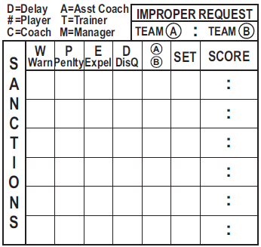
Notations in the Sanctions Box
IMPROPER REQUESTS
TEAM DELAY WARNINGS
TEAM DELAY PENALTIES
INDIVIDUAL PLAYER OR
TEAM STAFF WARNINGS
INDIVIDUAL PLAYER OR
TEAM STAFF PENALTIES
EXPULSION
DISQUALIFICATION
X
D
A
1
4
8
D
A
1
6
10
7
B
1
12
3
6
B
1
16
9
C
B
1
18
10
3
A
2
6
6
When there is an Expulsion or Disqualification,
NO point is awarded
Since all Sanctions are for the Match,
copy the entries to all set score sheets

Slide 55
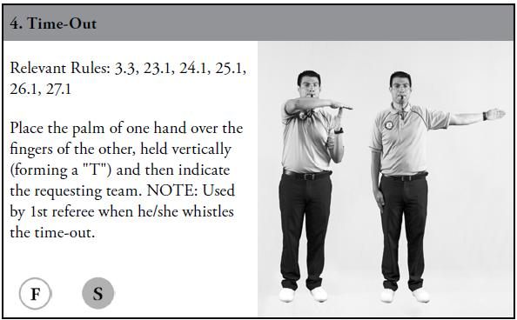
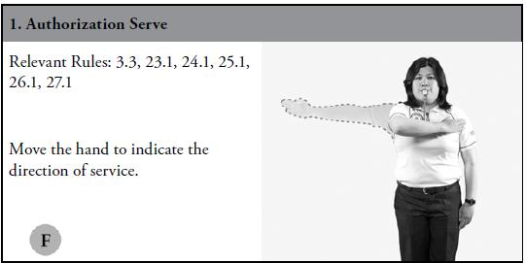
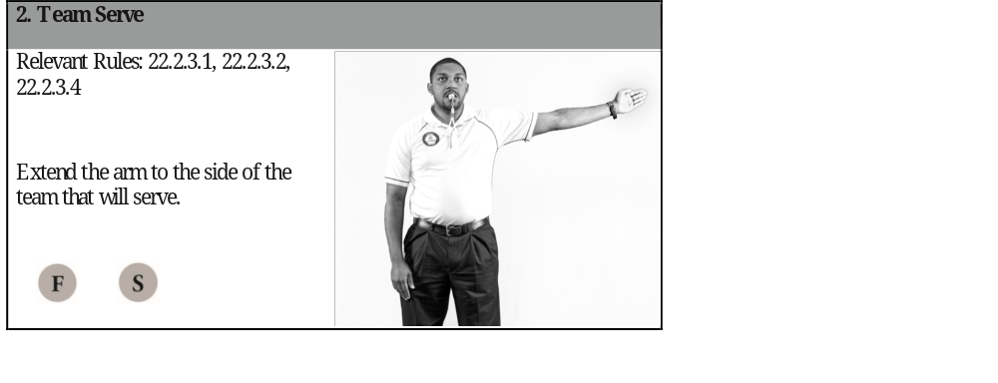
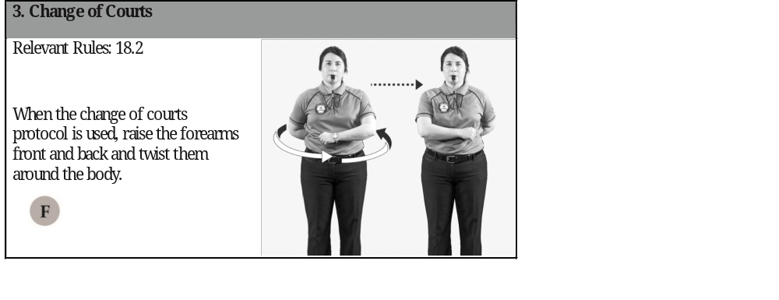
SIGNALS – PLEASE STAND

Slide 56
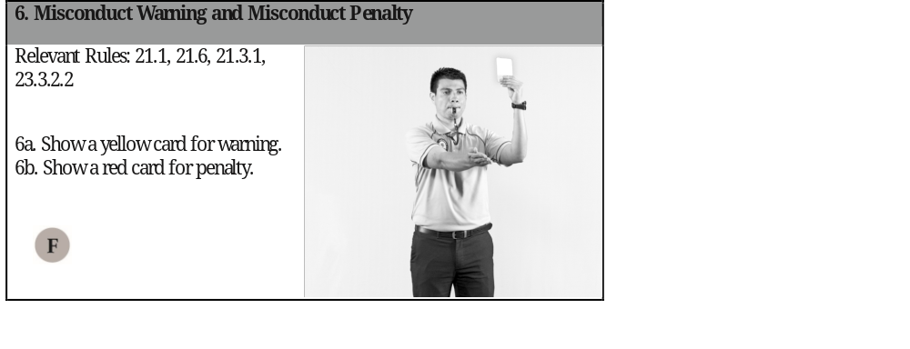
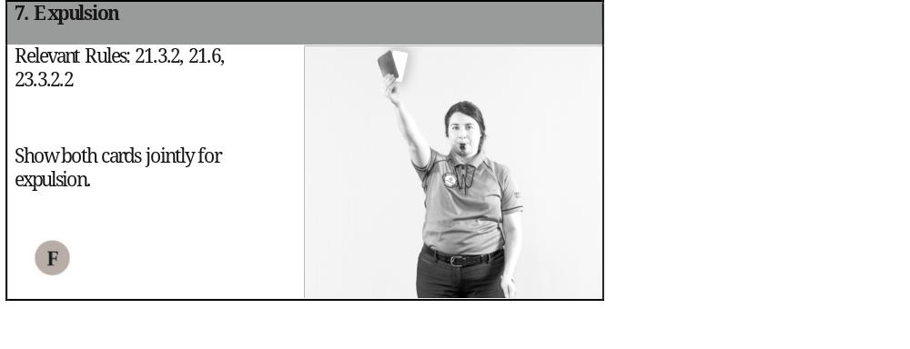
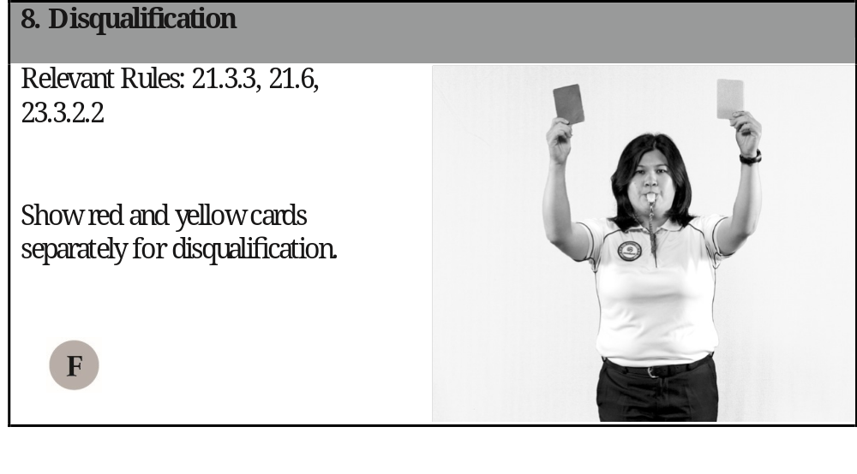
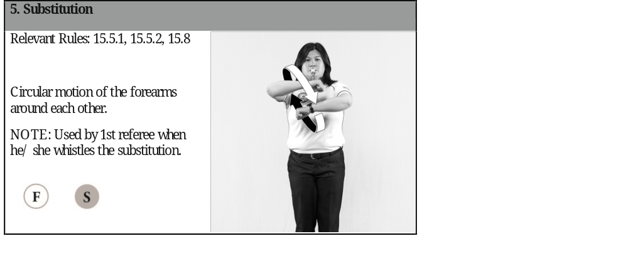
SIGNALS – PLEASE STAND

Slide 57
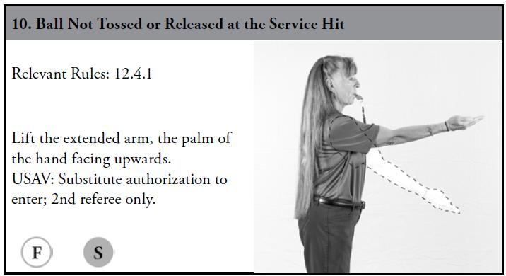
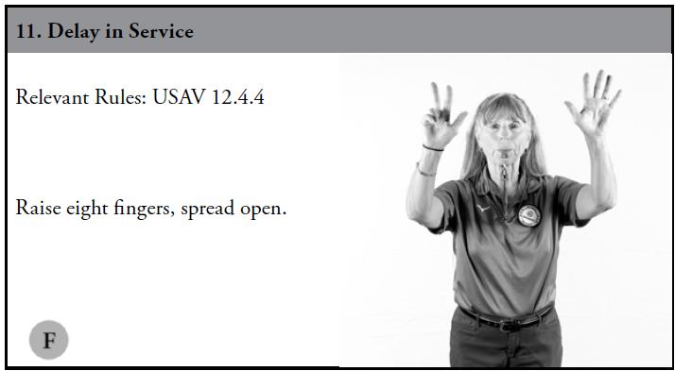
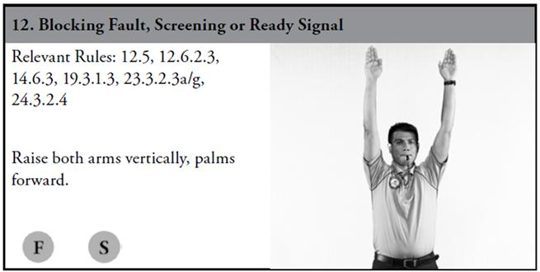
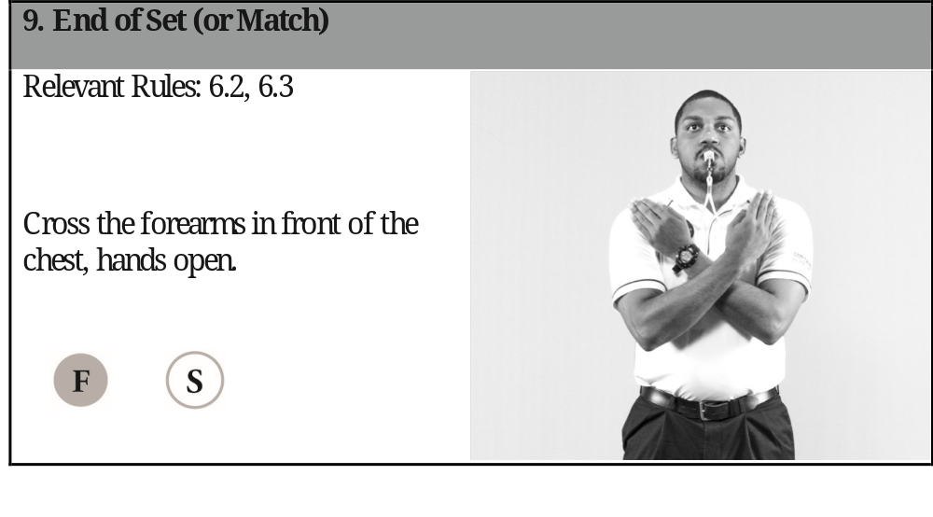
SIGNALS – PLEASE STAND

Slide 58
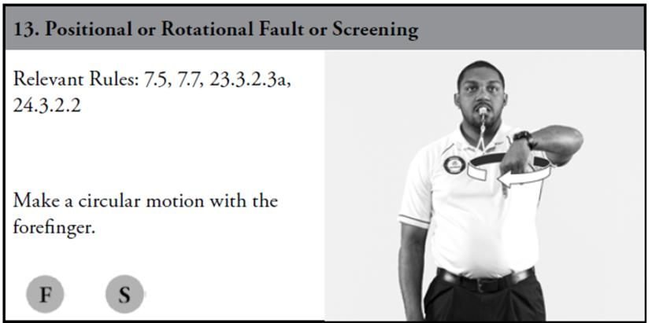
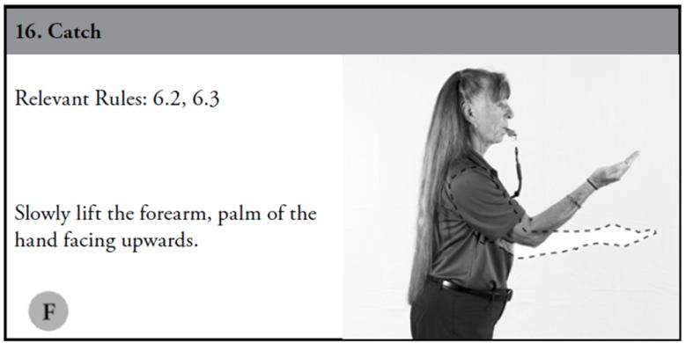
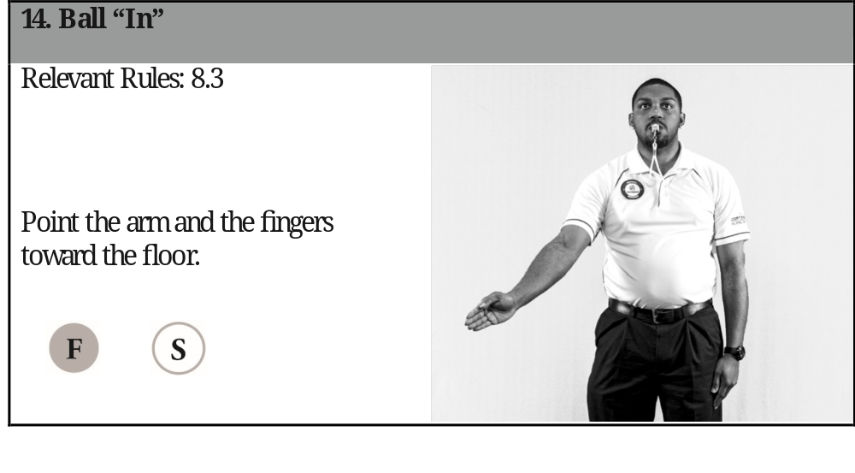
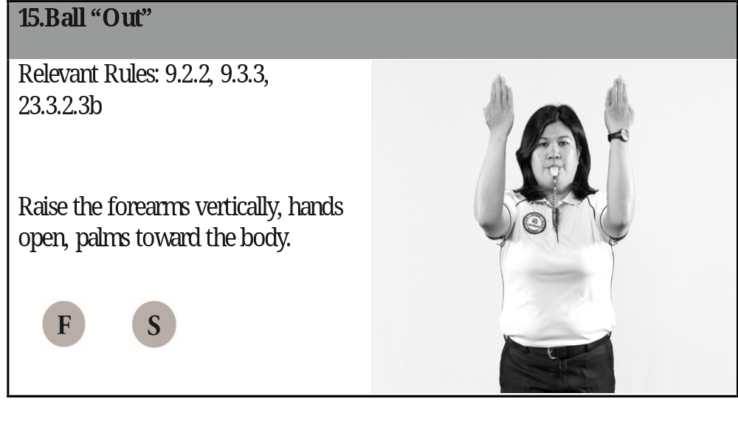
SIGNALS – PLEASE STAND

Slide 59
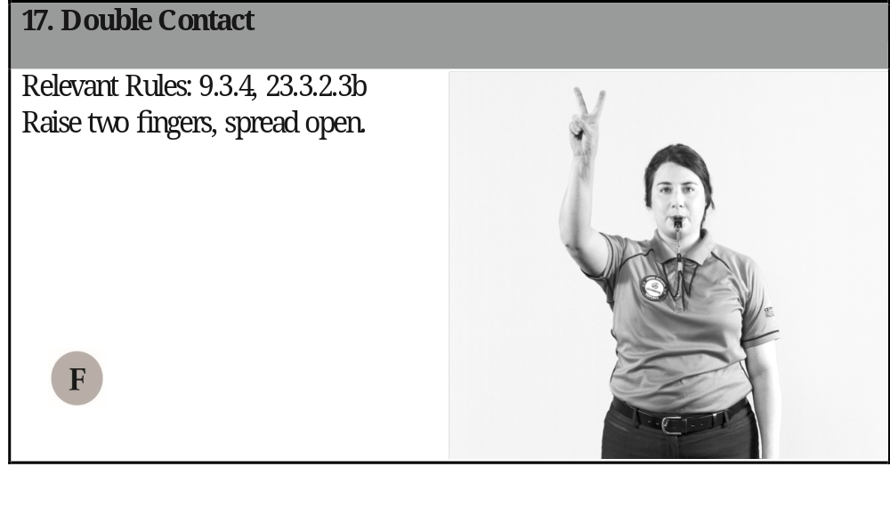
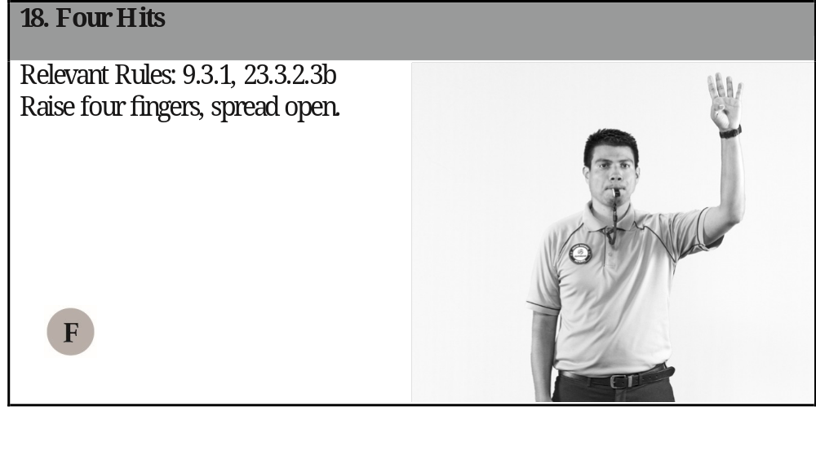
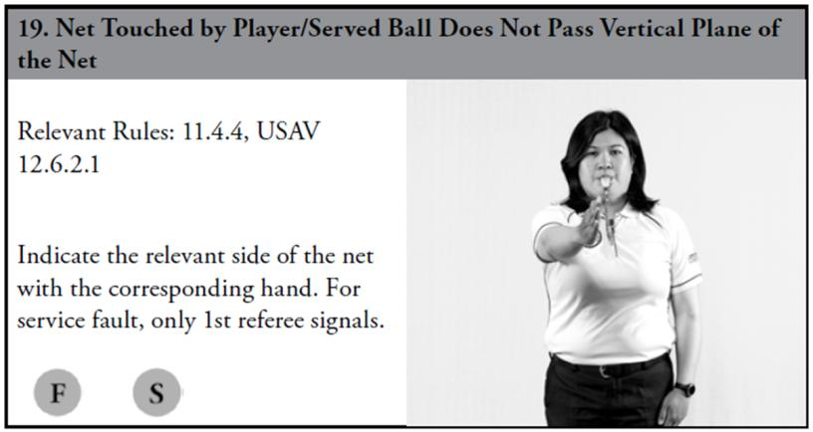
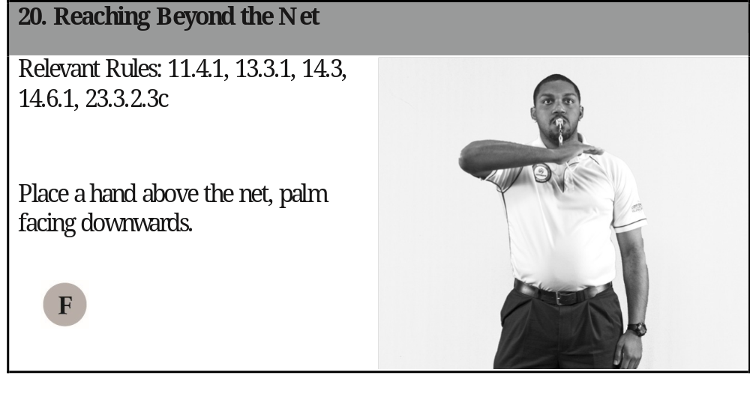
SIGNALS – PLEASE STAND

Slide 60
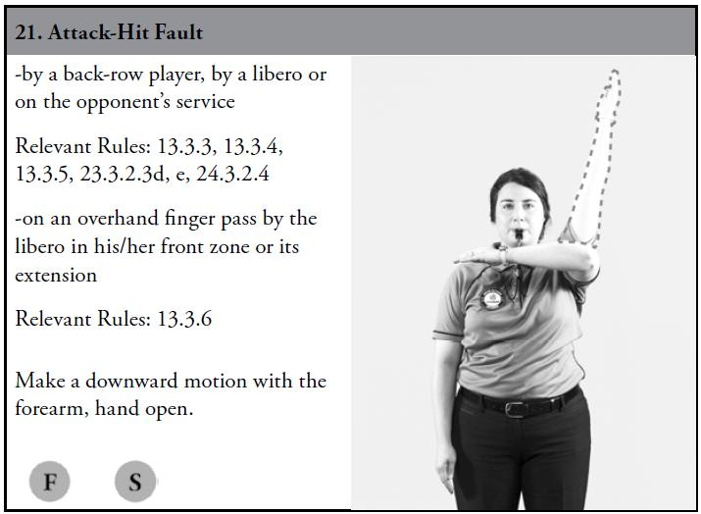
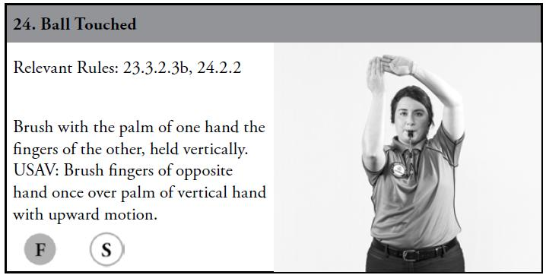
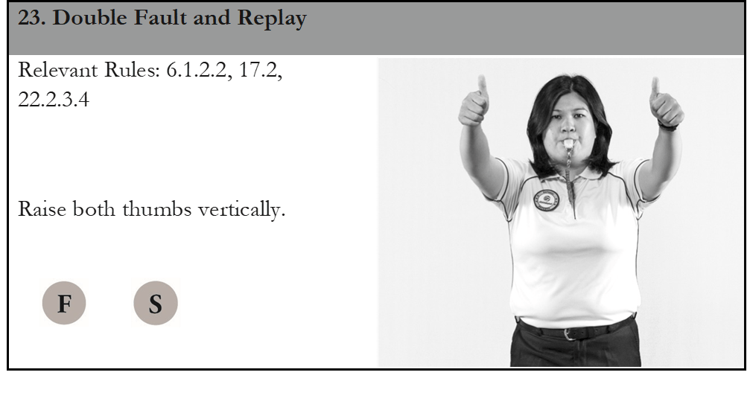
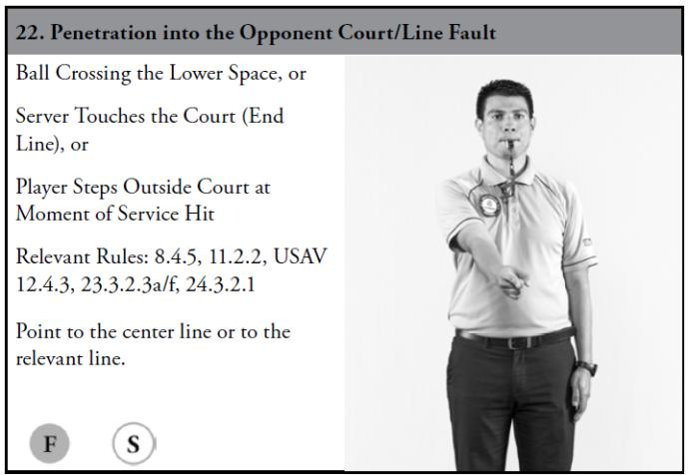
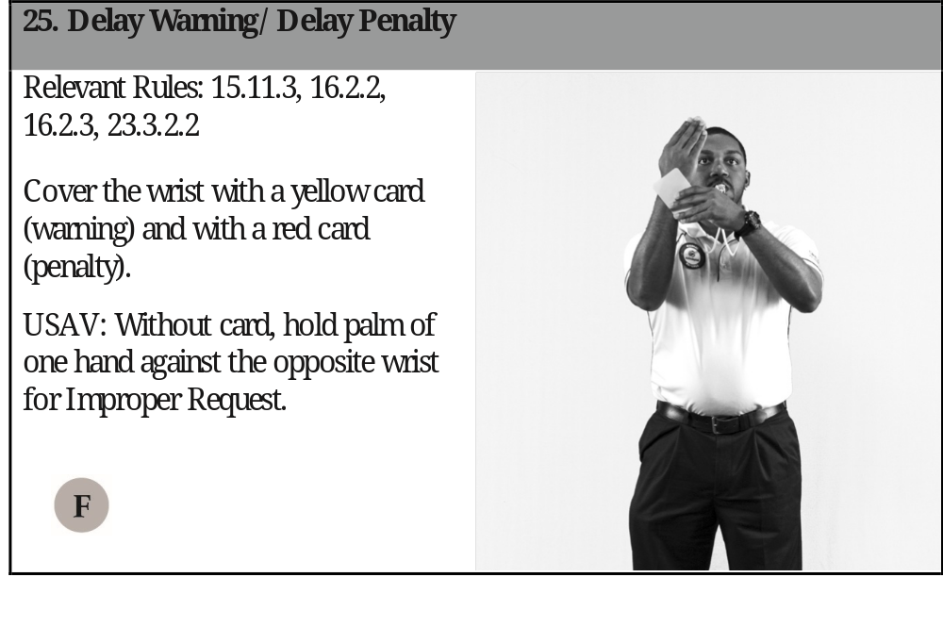
SIGNALS – PLEASE STAND

Slide 61
H I R O S
Harassment Incident Report-Officials & Staff
Any observed or reported harassment directed towards an athlete, coach, official, spectator or other attendee at a USAV event will be met with ZERO tolerance
Zero tolerance means harassment incidents will be investigated, and appropriate consequences will be imposed
If harasser is a coach or player / Harasser is disqualified for the match
  Head referee and staff is called to the court
  Suspend the harasser for the remainder of the tournament
  HIROS form filled out by R1 & head referee
  Play continues after investigation is complete / Harasser has been removed
A QR code will be created for officials, coaches, staff to link to the form
USAV Module in your Academy – Requirement to watch

Slide 62
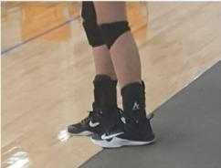
TRUE or FALSE
T
A special three-minute recovery time-out for an injury is only permitted when a player cannot be substituted legally or exceptionally.
While checking Team A’s line-up before the start of the set, the 2nd referee notices that player #7 is listed as both the Libero and one of the six starting players. The 2nd referee informs Team A’s coach that #7 must be a starting player, and another player must be designated as the Libero.
Team B has been assessed both a delay warning and a delay penalty during the current set. If the coach requests an excessive team substitution, the referees should assess an improper request.
It is legal for a server to start their serving
action from the position shown in this
picture.
F
T
T

Slide 63
TRUE or FALSE
F
While checking the line-ups at the start of the match, the 2nd referee notices that Team R’s #6 is on the court instead of #16. The coach says there is no #16 on the team. A team substitution, #6 for #16 must be recorded to allow player #6 to start the match.
While playing the ball, S4 touches the bottom tape of the net outside the antenna. The referees should whistle a net fault.
A line judge may signal when a player contacts either antenna.
Team R’s setter jumps and sets the ball near the top of the net. After the setter has released the ball, a Team S blocker reaches beyond the net in an attempt to block and touches the Team R setter’s hands. This is not a fault.
Team R’s first pass sends the ball into a non-playing area. As R4 is attempting to retrieve the ball from the non-playing area, a spectator deflects the ball to avoid being hit by it. The R1 awards a replay.
F
T
T
F

Slide 64
TRUE or FALSE
F
A Libero in the front zone jumps and attacks a ball that is partially lower than the top of the net. The 1st referee whistles and indicates an illegal attack by the Libero.
A team has only 6 players. During play, one of the players is unable to continue due to illness. The 1st referee should allow the team to continue playing with 5 players.
Immediately after receiving an improper request for substitution, the head coach for Team R requests the team’s second time-out. The 2nd referee should allow this time-out request.
While in the front zone, Team R’s Libero contacts the ball with an overhand finger pass (setting action). The ball enters the vertical plane of the net and is simultaneously contacted by R4 and S2. The 1st referee signals an illegal attack.
After blocking the ball, but before returning to the floor, a blocker contacts the body of the net. This net contact does not interfere with play. The referees allow play to continue.
F
T
T
F

Slide 65
TRUE or FALSE
T
A team is allowed to request up to 15 substitutions.
A team is lock in with the two liberos if they submit two liberos in the first set.
When a player commits a double contact and sends the second or third ball over the net without a teammate contacting the ball, you must whistle and call a double contact.
Players from the serving team can have their hand above their heads prior to teammates contact for serve.
The second referee must transition to the fault side of the net after a rally to mirror the R1’s signals.
F
T
F
T

Slide 66
REMINDER – SIGN OUT
Before you depart the clinic today, you must sign out.
Your signature confirms the certification that you applied for.
As a reminder, you can change your mind and request a different certification while you are here. Once you depart you cannot change your certification.

Slide 67
PASSING THE EXAM
ALL REFEREE TESTS are given at the clinic electronically. You must take your test at this clinic.
You can use a cell phone, tablet, or computer to take your test.
14 & under:
TEST D
70 is passing
15 & older & adults:
TEST C
70 is passing
Regional Referees:
TEST A
84 is passing

Slide 68
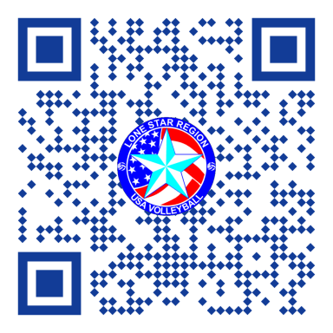
QR CODE FOR TESTS
WEBSITE FOR TESTS
HTTPS://LSRrefs.com/exams

Slide 69

HAVE A GREAT SEASON!
http://www.lsvolleyball.org

