Slide 1



Administrative Slide
Most pages are automatic, wait for the picture to appear at the bottom left of the page before going to the next slide
If you see ,it means you need to advance the slide
(click the mouse, press the Enter key, Page Down or press the down arrow)

Slide 2

Scorer Certification
Junior Scorer Test Review
Rev. 11/13/25

Slide 3
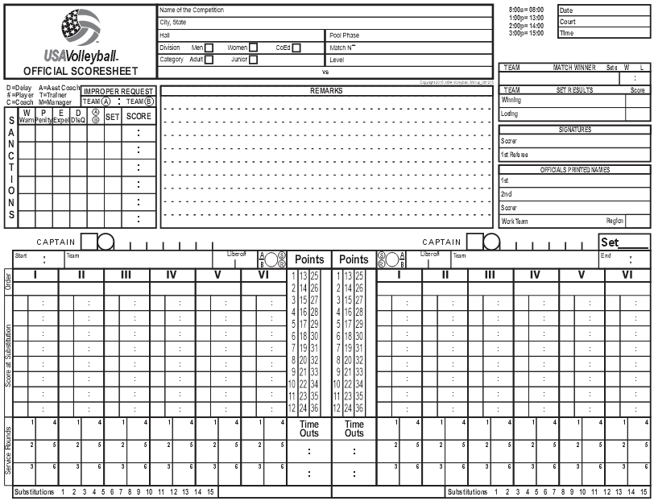
Junior and Provisional Scorer Test Review
1. Team A is serving from your left. List the areas that should be completed
in pen, prior to the first serve. (7 Points)
4
2
7
9
9
8
10
10
12

Slide 4

Junior and Provisional Scorer Test Review
2. Opponents may see the line-ups submitted by the opposing team prior
to the start of play.
□ True □ False (3 Points)
X
3. The scorer checks the number in the service rounds box when: (3 Points)
□ A. The ball crosses the net
□ B. The referee blows the whistle
□ C. The server legally contacts the ball for service
□ D. The server tosses the ball
□ E. The scorer feels like it
X
4. Heading information is written in all caps on the score sheet
□ True □ False (3 Points)
X

Slide 5
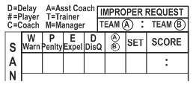
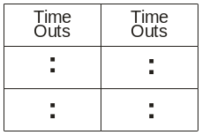
Junior and Provisional Scorer Test Review
5. What is the maximum number of normal substitutions allowed per set?
□ 2 □ 6 □ 12 □ 15 (3 Points)
X
6. After using 15 substitutions, the White team (A) calls for player #9 to
substitute for player #2. Team A is ahead 14-9 in set 1. What entry
should you make in the Sanctions box? ”(3 points)
Note:
The R2 tells you “Improper Request, Team A”
X
7. The Blue team (B) asks for a time out in set 2 when their opponents are
leading by a score of 9 to 1. Make the appropriate entry: (3 points)
Hint: Think where Team B is in the 2nd set.
1 9

Slide 6

Junior and Provisional Scorer Test Review
8. No two exit scores will ever be the same. (Unless acted on by the Referee)
□ True □ False (3 points)
X
9. The Libero is allowed to be floor captain in USAV play?
□ True □ False (3 points)
X
10. In set 1 with the score 5-5, team B does something to make the referee
hold a yellow card against his wrist with this signal. Make the correct
entry in the sanctions box below. (3 points)
D B 1 5 5

Slide 7
Junior and Provisional Scorer Test Review
11. The wrong server is about to serve.
When do you announce “Wrong Server!” to the R2? (3 points)
□ A. Before the referee blows the whistle for serve
□ B. After the whistle, but before the serve is made
□ C. After the server contacts the ball for service
□ D. After the rally has ended
X
12. The referee verbally warns player #1 on the Blue team (B) for
un-sportsmanlike conduct. The score is 9 to 9. Is an entry made on
the score sheet?
□ Yes □ No (3 points)
X

Slide 8
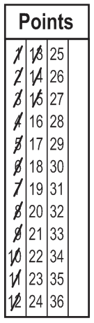
Junior and Provisional Scorer Test Review
13. Is the Libero allowed to serve in USAV play?
□ Yes □ No (3 points)
X
14. At 15-15 in set 2 the referee pulls out a red card and says:
“Player # 1, Blue team (B) for un-sportsmanlike conduct”
and signals a loss of rally.
How do you show this point on the White team's side,
assuming it happened after point 15? (3 points)
/
O
15. What would you write in the Sanctions section for the
situation in the previous question? (3 points)
1 B 2 15 15

Slide 9
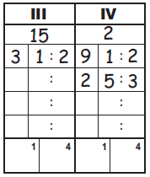
Junior and Provisional Scorer Test Review
16. A non-deciding set is won by the first team to reach 25 with a
two-point lead.
□ True □ False (3 points)
X
17. The scorer notifies the R2 that the incorrect player has served the ball.
Blue team (B), player #2 served instead of player #3. The score is
7 to 3 in set 2, Blue leading. Mark the score sheet at the right.
Include the Sanctions entry, if necessary. (3 points)
No entry is made in SANCTIONS
7

Slide 10
Junior and Provisional Scorer Test Review
18. During time-outs the scorer indicates to the referee the number of time
outs that have been taken by each team. □ True □ False (3 points)
X
19. When a player substitution is made the following is recorded on the score
sheet: the exiting player’s number is slashed, the entering player's
number is recorded, the score is noted in the Score at Substitution
section and the total number of Substitutions is slashed.
□ True □ False (3 points)
X
20. Do you enter the libero players on the score sheet?
□ Yes □ No (3 points)
X
21. If a player is expelled or disqualified a penalty point or loss of rally is
also awarded. □ True □ False (3 points)
X
22. All sanctions remain in effect for the entire match and are carried over
to succeeding set score sheets. □ True □ False (3 points)
X

Slide 11
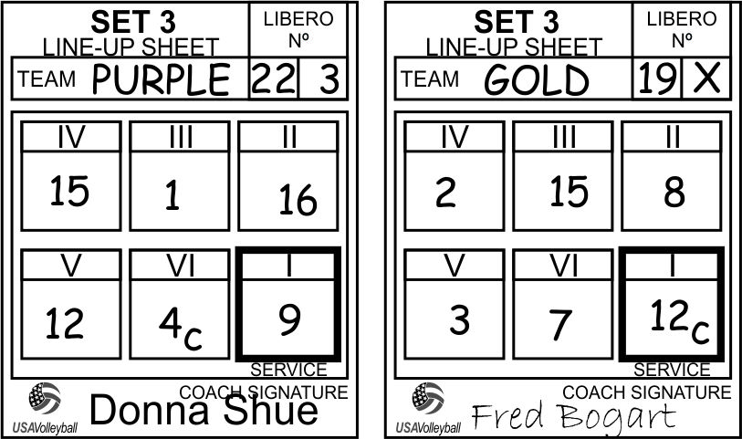
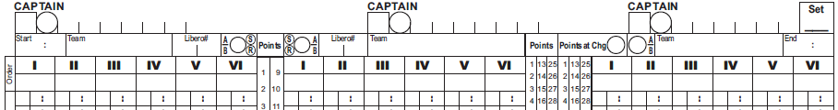

Junior and Provisional Scorer Test Review
23. Fill out the third set score sheet example below. The Purple team (A)
serves first from your left. (15 Points)
4
13
9
15
X
4
5
2
11
14
X
12
X
4
3
A
6
PURPLE
1
₂₂ ₃
^{x}
_{X} B
_{19 X}
GOLD
10
A
PURPLE
7
9 16 1 15 12 4
12 8 15 2 3 7
9 16 1 15 12 4
3
12
8
24. The referee makes the following signal.
Do you make any entry on the score sheet?
□ Yes □ No (2 points)
X

Slide 12
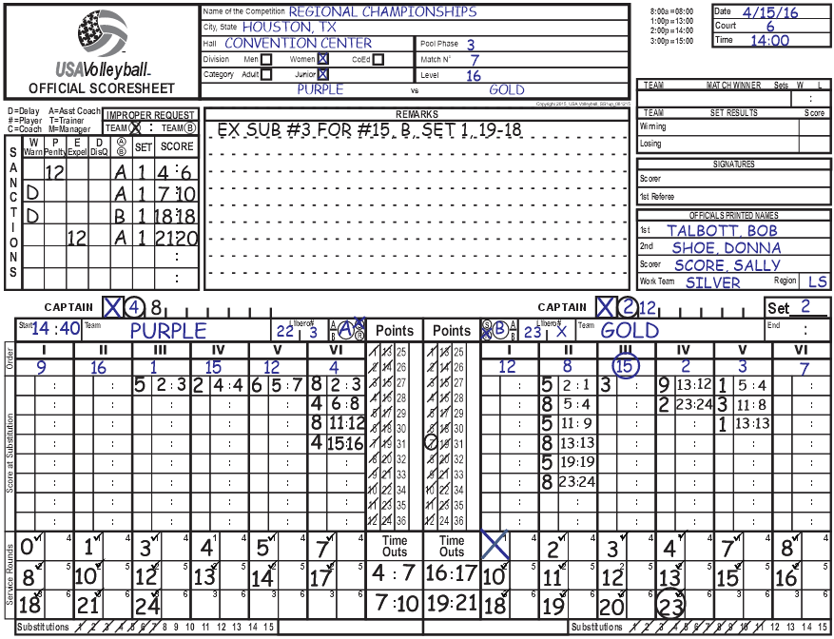
Junior and Provisional Scorer Test Review
25. Gold #2 serves the ball out which results in Purple winning set point on a side out at 3:02 P.M. This is a 2 of 3 match. Purple won set 1 25-9.
Complete this scoresheet showing all required entries. Enter an “X” for signatures. (13 points)
8
PURPLE
2 0
9
6
PURPLE
25
7
GOLD
23
X
12
13
X
1
15 02
3
/
10
11
25
5
2
4

Slide 13
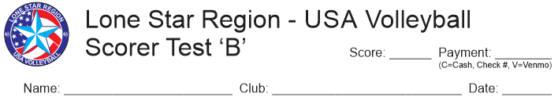
Be SURE the heading of your test
is complete before you turn it in!
Name, Club & Date
Score & Payment

Slide 14

Remember:
Scorer Certification Requirements
Register In the Lone Star Region (USA Volleyball Membership in Sports Engine)
Submit application – (pre-register online or at a clinic)
Attend clinic
Take and correct exam
Receive a passing evaluation on score sheets from two sets
at a live match where you are the scorer.
(submissions may be email to: lsrscorechair@gmail.com or paper)
The absolute FINAL date for submission of score sheets is 8/31/26!
Pay applicable fees
* * A COMPLETED certification is good for two seasons. * *
* Remember: It is your responsibility to submit score sheets from two sets. *

Slide 15
Junior and Provisional Scorer Test Review
fin

